Slide 1

Welcome to….
Innovative Techniques to Clear-Up the
Most Common Grammatical Misuses
“Make abstract grammar concepts more concrete. Discover fun and effective techniques to correct common errors.”
By Gelene Strecker-Sayer, NBCT
ESOL Teacher/ELD Specialist
MIDTESOL Conference - October 21 & 22, 2011 - St. Louis, MO gelene@eslanswers.com

Slide 2
Focusing on ……
Present tense conjugation
Irregular Past Tense
Prepositions

Slide 3

Corrective Feedback
Types of Errors students make
Phonological/Pronunciation 29%
Grammatical 56%
Lexical 11%
Content 6%
Discourse 8%
Lexical errors were the most commonly
corrected. Considered the easiest to correct.
Chadron, 1988

Slide 4

Error Correction & Types:
Teacher Feedback Student Repair
Recast 55% 0%
Clarification Request 11% 20%
Elicitation 14% 43%
Metalinguistic 8% 26%
Explicit Correction 7% 0%
Repetition 5% 11%
*Elicitation draws attention to error but doesn’t provide answer.
Proposition: Change the way we provide feedback &
utilize more innovative ways to teach & learn grammar.
Loewen, S., 2007 / Tedick, D. & de Gortari, B., 1998

Slide 5
Why might students have difficulty
with discrete language points?
- Language interference
- Learning to reading, write, listen &
speak simultaneously
Listening is the first step!
Move from listening in a general/broad way.
Part of the process is retraining their ears to ‘hear’ the smaller sounds/elements in language.

Slide 6

What to do???
Move beyond recasts…
Help students
break the cycle,
break old habits
and form better ones by
using these techniques!!!

Slide 7


      The BRAIN is dynamic
      & thrives on novelty!!
So use take advantage of it
when teaching &
designing strategies…
It is not only more fun
but also effective!!

Slide 8



The key is to hand over ownership of learning by
directly teaching students how to build and use their metacognition, so they…
can create & use relevant strategies to help them recall information & become independent learners.
  Show them how to:
  STOP…
  Think about a strategy…
  Apply it!

Slide 9

PRESENT TENSE VERB CONJUGATION
STOPS & GO- A Visual Activity for Understanding!!
Use Traffic Signal TO SIGNAL STUDENTS!!
  Singular- StopS and addS /S/
  Plural- Keep on GOing’
  Students must understand concept of singular/plural
  Students must also understand sentence order S-V

Slide 10

The basis of STOPS & GO:
Provide students with kinesthetic, oral and
visual tool to help recall how to use the present
tense accurately in reading, writing and speaking.
How to:
‘If the noun is Singular, then…
STOPS and adds /S/’ (notice the sibilant /s/ )
RED to signify ‘STOPping’.
The flower grows. A boy runs.

Slide 11

The basis of STOPS & GO:
‘If the noun is plural, then…
‘keep on GOing’.
GREEN to signify ‘continuing/GOing’
The flowers grow. The boys run.
** Special Pronoun ‘I’ to follow plural rule “I GO” **

Slide 12
My friend play??
The cat jump??
They is??
Huh????
He have??
We was??
STOPS & GO can be used with various present
tense verbs that students have difficulty using:
**Regular present tense- runs, goes, jumps, hides, plays
**Has/Have
** ‘I’ to follow plural rule “I GO” **
Is/Are - “I am special”
------------------------------------------------------------------------------------------------------------------------------------------------------------------------------------------------------------------------------------------------------------------
& Past Tense Was/Were - “I was disappointed….”

Slide 13

PRESENT TENSE VERB CONJUGATION
Activities/Ways to Incorporate
In a group/oral practice:
Shouting out “Stop/Go”.
Using hand signals OR student made Stop-Go signs.
Reading Practice:
Students read a passage/paragraph to each other and LISTEN for verb tense usage
Students read something they have written to each other and listen for verb tense usage. (both have copy of what is written to check for oral/written errors)

Slide 14
PRESENT TENSE VERB CONJUGATION
Activities/Ways to Incorporate
In written practice:
Students write and check their writing using red/green pens or highlighters
Making own worksheets include traffic signal & road, drive mini-Match Box® cars, stopping at the
‘intersection’ of ‘Subject’ & ‘Verb’.
In pre-made worksheets or in student writing,
draw traffic signal at the beginning of sentences
& color light accordingly.

Slide 15
Add Traffic Signal Box to the front of Pre-Made Worksheet:
He _______ (is/are) going to the store.
0
0
~~~~~~~~~~~~~~~~~~~~~~~~~~~~~~~~~~~~~~~~~~~~~~~~~~~~
Highlight nouns in Pre-Made Worksheet:
My friend Jack has a dog. The dog is named Spot. Jack and
Spot take a walk everyday. Sometimes Jack keeps Spot at home.
~~~~~~~~~~~~~~~~~~~~~~~~~~~~~~~~~~~~~~~~~~~~~~~~~~~~~~~
Make Your Own Worksheets w/Traffic Signal Boxes:
He eat/eats his lunch at school.
Driving in a sentence: -----------------------------------------------------
The cats has/have milk.
Driving in a sentence: -----------------------------------------------------
0
0
0
0

Slide 16
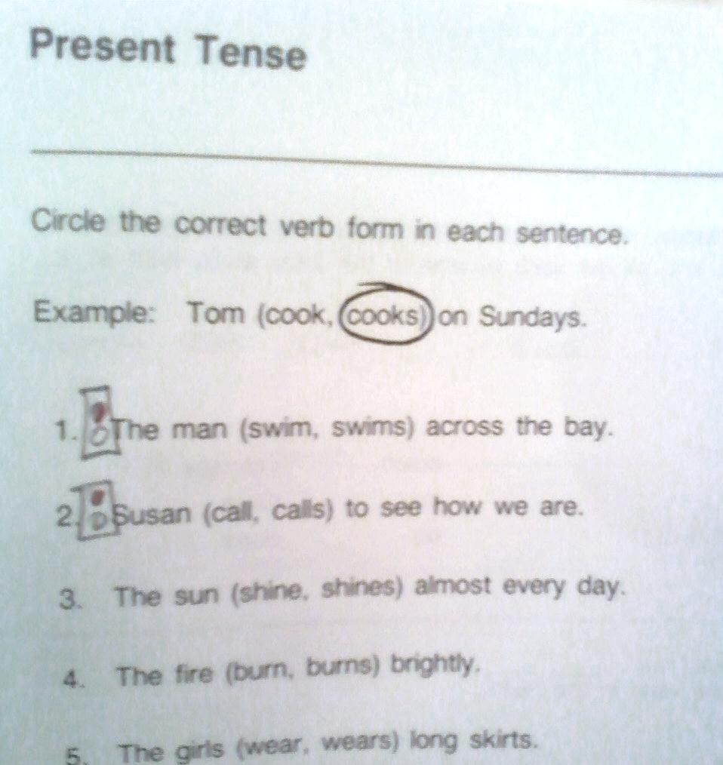
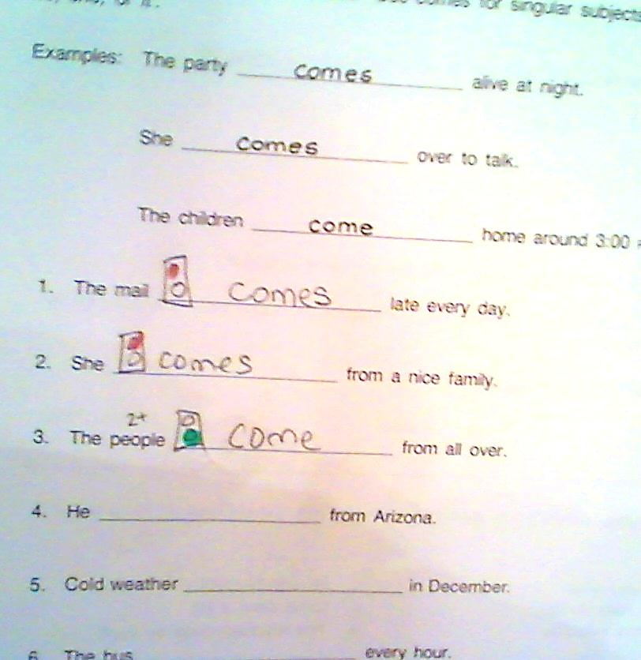
Add Traffic Signal Box to Pre-Made Worksheet
:

Slide 17
IRREGLAR PAST TENSE ACTIVITY
think-thought, buy-bought, fight-FIGHTED!!!
Color-Coded Irregular Past Tense Flash Cards
These can be used as a form of student practice as well as a quick & straightforward assessment tool. The cards are grouped by a coding system which makes it easy for teacher and students to see patterns of use and misuse.
think
thought

Slide 18
GREEN - verb stays the same:
put/put, hurt/hurt, pet/pet, cut/cut
LIGHT GREEN- drop mid or ending vowel to make word have short vowel
meet/met, hide/hid, lead/led
GRAY - verb changes, but not in reliable pattern
pay/paid, read/read, took/take, fall/fell
RED - verb changes to a completely different word
eat/ate, is-are/was-were, go/went
PURPLE- middle vowel/vowels change to /o/
wake/woke, choose/chose, wear/wore
YELLOW - initial consonant/s remain, rest of word changes to /ought/ or /aught/
think/thought, fight/fought, bring/brought
BLUE – final /d/ is replaced by /t/
build/built, bend/bent
LIGHT BLUE-/ee/ changes to /e/ and add /t/
sleep/slept, keep/kept
PINK - middle vowel changes to /a/
give/gave, come/came, sing/sang, drink/drank
BROWN retain initial blend and add /ew/
fly/flew, grow/grew
ORANGE- replace /i/ with /u/
fly/flew, know/knew, grow/grew

Slide 19
Show students that they are smart and already KNOW many right answers
Now I ….. Yesterday I…..
know
knew
grow
grew
fly
flew
Connecting what they don’t yet know to what they DO know ☺

Slide 20
IRREGULAR PAST TENSE ACTIVITY
think-thought, buy-bought, fight-FIGHTED!!!
Color-Coded Irregular Past Tense Flash Cards
  * Organize them into groups and look for patterns.
  Students can play with flash cards practicing first with
  present tense, then work in reverse.
  * Can be made into regular one sided cards for students to
different games; Matching, Go Fish, Old Maid, etc.
* Change ALL to black, remove color cue when writing.
* Teacher can assess kids to see which ones they know.
* These can be made by students, used by anyone & taken
home to share with family.

Slide 21
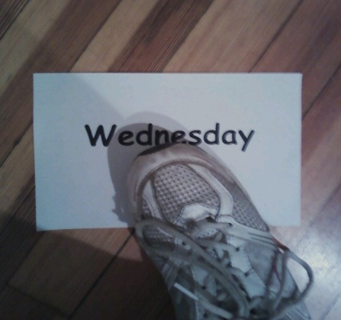
PREPOSITION ACTIVITIES
‘At Saturday’ Floor Activity
Supplies physical sense of “ON” & connects to
idea of “Smaller pieces/chunks of time”
Put papers with days of week on the floor or write on tile with dry erase marker.
2. Students walk/jump/leap from day to day, saying “ON………..”
3. Expand “On Saturday, I played with my friends”….
4. Can include holidays:
‘On Eid’, ‘On Dawali’, ‘On Christmas’, ‘On my birthday’, etc.
5. Put days together:
‘On break’, ‘On vacation’, On the weekend’
6. Extend into writing; make a journal or book.
7. Read each other’s journals or books.

Slide 22
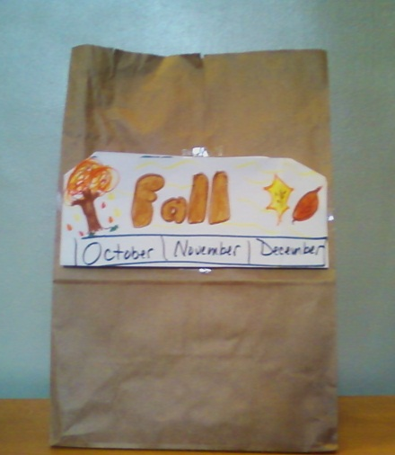
PREPOSITION ACTIVITIES
Months & Seasons ‘IN’ a Bag Activity
Supplies physical sense of “IN”
& “Larger spans of time” b/c larger object
Get boxes/paper bags/milk crates- something for students to safely put over head or stand in---NO PLASTIC PLEASE!! ☺
2. Decorate each side winter, spring, summer, fall
& corresponding months.
3. Stand in or put paper bag/box on head; say: “IN…..”
4. Expand to sentences to include topics like; weather, clothing,
things people do, what it is like in other countries, etc.
5. Extend into writing; make journal, book, essay, etc.
6. Read each others’ journals or book.

Slide 23
PREPOSITION ACTIVITIES
‘My pencil is ON my classroom’ Walking Activity
Personal Placement Prepositions- ‘to’, ‘in’, ‘at’, ‘on’
Supplies physical sense, reinforcing difference.
Take students on walk to places in school whispering,
“I am walking TO the library/gym/office.”
2. STOP at the door and say:
“I am AT the library/gym/lunchroom.”
3. Pass thru the door into the room and say:
“I am IN the library/gym/lunchroom.”
4. Follow up with a trip to the playground repeating each step:
“I am walking TO”, “I am AT” & “I am ON the playground!”

Slide 24

Move from using recasts & traditional handouts to teach & correct misuses…
To providing strategies & techniques for the students to utilize…
Incorporating more discrete listening practice
We put the ability & responsibility
for learning in their hands..

Slide 25



In the end..
A more independent learner =>
more competent learner =>
more confident learner =>
a happier kid!!

Slide 26

For FREE copies of the cards to print out go to www.eslanswers.com
Click on ‘Innovative Teaching Ideas’
& look for titles “Innovative Grammar”
They will be assessible until Nov 5th ☺

